Slide 1

Simulating the Cognitive Thought process with a Modified Genetic Algorithm
150
Poojangi Ashok Gadekar
Dr. Shubhangi Vinayak Tikhe
Poojangi Gadekar - MKSSS’s CCOEW, Pune
September 24, 2021

Slide 2

Abstract
Cognitive Computing aims to develop computing methodologies inspired by the mind’s capabilities.
The purpose of the paper is to simulate the Thought Process with a simple approach.
The paper proposes that the Genetic Algorithm can be used for the same.
The modification to the GA is also proposed to improve the simulation.

Slide 3
Introduction
There are two aspects of the paper:
1. Perspective of GA to simulate the Thought Process.
2. Proposing a modified GA for better simulation and check its feasibility.
For that, TSP is used as the research object.
In the modification of GA, a new supplementary crossover named Learning Crossover is proposed. The Learning Crossover also has scope of improvement in the performance of GA.
Notes:
Simulation of thought process is how mind traverses the thoughts.

Slide 4
Literature Review
No. | Reference Title
1. | Y. Wang et al., "Perspectives on Cognitive Informatics and Cognitive Computing: Summary of the Panel of IEEE ICCI'09," 2009 8th IEEE International Conference on Cognitive Informatics, 2009, pp. 9-27, doi: 10.1109/COGINF.2009.5250815.
2. | By Dharmendra S. Modha, Rajagopal Ananthanarayanan, Steven K. Esser, Anthony Ndirango, Anthony J. Sherbondy, Raghavendra Singh Communications of the ACM, August 2011, Vol. 54 No. 8, Pages 62-71; 10.1145/1978542.1978559
3. | J. O. Gutierrez-Garcia and E. López-Neri, "Cognitive Computing: A Brief Survey and Open Research Challenges," 2015 3rd International Conference on Applied Computing and Information Technology/2nd International Conference on Computational Science and Intelligence, 2015, pp. 328-333, doi: 10.1109/ACIT-CSI.2015.64.
4. | Shadrikov, V., Kurginyan, S., Martynova, O. (2016) Psychological Studies of Thought: Thoughts about a Concept of Thought. Psychology. Journal of Higher School of Economics, 13(3), 558-575, DOI: 10.17323/1813-8918-2016-3-558-575
5. | P. Wang, "Learning and Control of Human-Like Thinking Process", 2006 International Conference on Machine Learning and Cybernetics, 2006, pp. 850-854, doi: 10.1109/ICMLC.2006.258484.

Slide 5
Literature Review
No. | Reference Title
6. | Y. Wang et al., “The cognitive process and formal models of human attentions,” International Journal of Software Science and Computational Intelligence, vol. 5, no. 1, pp. 32-50, 2013.
7. | S.N.Sivanandam · S.N.Deepa, “Introduction to Genetic Algorithms”, Springer-Verlag Berlin Heidelberg 2008, doi: 10.1007/978-3-540-73190-0
8. | Abid Hussain, Yousaf Shad Muhammad, M. Nauman Sajid, Ijaz Hussain, Alaa Mohamd Shoukry, Showkat Gani, "Genetic Algorithm for Traveling Salesman Problem with Modified Cycle Crossover Operator", Computational Intelligence and Neuroscience, vol. 2017, Article ID 7430125, 7 pages, 2017. https://doi.org/10.1155/2017/7430125
9. | Otman Abdoun, Jaafar Abouchabaka, Chakir Tajani, “Analyzing the Performance of Mutation Operators to Solve the Travelling Salesman Problem” arXiv:1203.3099 [cs.NE]
10. | F. Yu, X. Fu, H. Li and G. Dong, "Improved Roulette Wheel Selection-Based Genetic Algorithm for TSP," 2016 International Conference on Network and Information Systems for Computers (ICNISC), 2016, pp. 151-154, doi: 10.1109/ICNISC.2016.041.

Slide 6
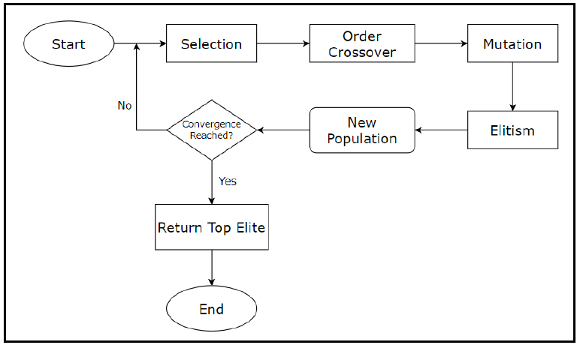
Basic Genetic Algorithm

Slide 7
Proposed Work
Thought Population
GA Operations
New Thought Creation
Initialization: New thought creation based on state of mind, etc.
Mutation: Linking from previous thoughts
Elitism: Carrying forward previously held thoughts
Crossover: Inferring from 2 or more thoughts
New Thought Population
Convergence
No
Yes
End
GA for Thought Process Simulation
Notes:
The Cognitive Process and Formal Models of Human Attentions
Yingsu Wang

Slide 8
Modification to GA
Start
Selection
Topper set
One difference is that, when mind traverses between thoughts, it learns from the previous thoughts, which is used while creating new thoughts.
This Learning factor is added in the GA with the Learning Crossover Operator.
The fitter thoughts from previous populations can be stored and knowledge can be extracted out of them.
Order Crossover
Pattern Recognition
Mutation
Subtour set
Elitism
Learning Crossover
New Population
No
Convergence
Yes
End

Slide 9
Implementation on TSP
The paper proposes the theory of Simulation. And to understand its feasibility, it is implemented on common NP Complete problem – Travelling Salesperson Problem.
TSP is solved with both basic GA and modified GA for comparison.
For TSP, city route is gene.
Modified GA:
Previously generated fitter individuals are stored and common subtours are extracted out of them.
These common subtours are given to the Learning Crossover operator which uses them to create new individuals.
These new individuals are then given to the remaining operators of GA for further actions.

Slide 10
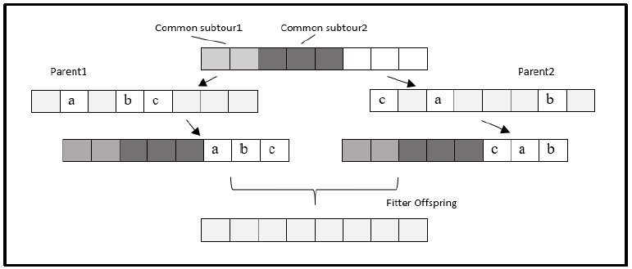
Learning Crossover
The extracted common subtours are stored in a set.
Crossover on all the subtours in the set is performed as below.
Two new individuals are generated and the fitter among the two is then given to the next operators.

Slide 11
Result Analysis
The paper proposes a theory of simulation and the goal was to check the feasibility.
The modification was not implemented with the goal of improving the performance of GA, but still it was compared with basic and existing GA, to understand its performance.
It is found that modified GA works better over small number of cities, both in case of basic and existing GA.
This is so, because, the modification is added to the basic version of GA, and the version is not enhanced to work better on greater population. The modified GA increases the population more than the basic GA, which degrades its performance for more cities.
But this issue can be handled to make modified GA better.

Slide 12
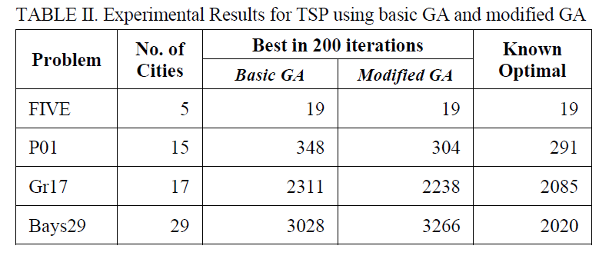
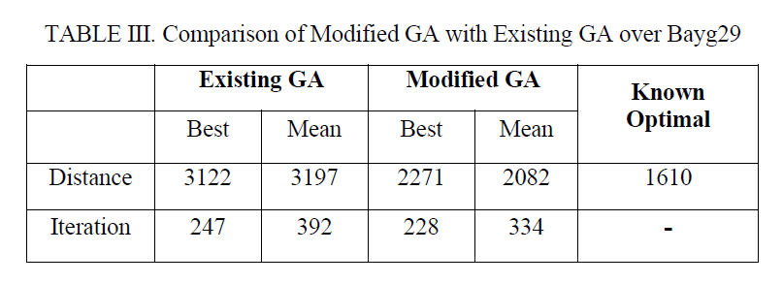
Result tables for the Paper

Slide 13
Conclusion
The concept of Natural Selection in case of Thought Simulation is found achievable.
The model proposed is to be considered as a base framework for the Thought Simulation.
Future work can be focused on further exploring the concept to be implemented in cognitive thinking.
Further work can also be focused on improving the Learning Crossover Operator.

Slide 14
Thank You
Questions?

Slide 15
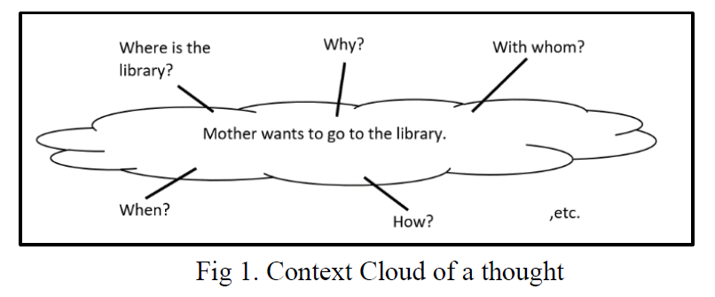
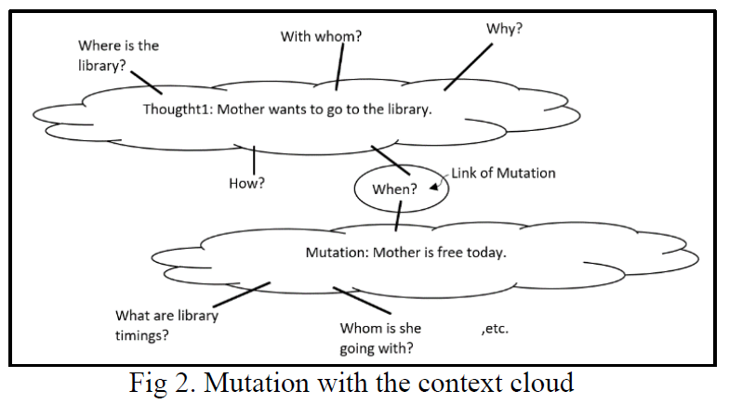
GA operators in New Thought Creation

Slide 16
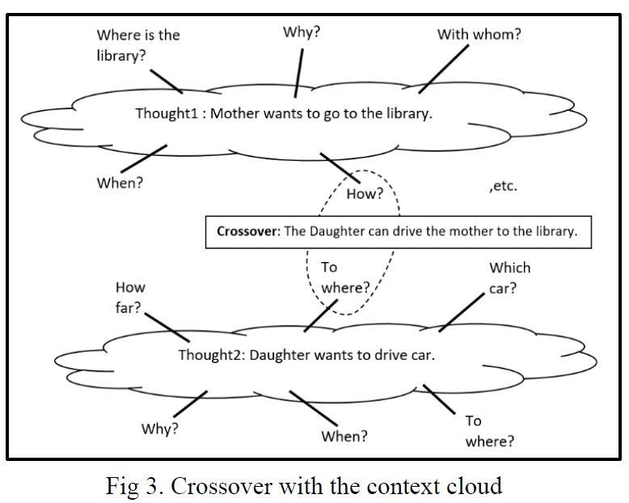
GA operators continued

